Slide 1
FEEL THE BURN CA WILDFIRES – AN ANALYSIS
Presented by: Sophie Wang, Devin Barger, Amy Wei and Mana Ghazanfari
12/21/2019

Slide 2
ANALYSIS
(1) Do dry and/or excessive heat patterns with lack of moisture/rainfall contribute to the spread of wildfires and the inability to extinguish fires, causing greater than anticipated damage?
(2) Is there a correlation between historical wildfires in California and the climate and weather patterns for California?
(3) Can this correlation tell us what may lead to reoccurrence for future fires?

Slide 3
TERMINOLOGY
WEATHER - the state of the atmosphere at a place and time as regards heat, dryness, sunshine, wind, rain, etc.
CLIMATE - the weather conditions prevailing in an area in general or over a long period.
WILDFIRE - an uncontrolled fire in an area of combustible vegetation occurring in rural areas. Depending on the type of vegetation present, a wildfire can also be classified more specifically as a brush fire, desert fire, forest fire, grass fire, hill fire, peat fire, vegetation fire, or veld fire.

Slide 4
BIGGEST DRIVERS OF FIRE BY CLIMATE
WINDS
TEMPERATURE
MOISTURE
Non weather related – fire fighter, resources and aid provided by State and Federal level, fire prevention and more.

Slide 5
METHOD - APPROACH TO RESEARCH
Leaflet geo map of California plotting the locations of wildfires over the past 6 years.
Descriptive statistics & charts for most heavily affected CA counties, acres burned, fire duration.
Temperature & precipitation charting to show climate trends for the area.
Visualized weather baseline for the area
Created data sets for county level data to parse for analysis not available to be scraped or accessed through JSON

Slide 6
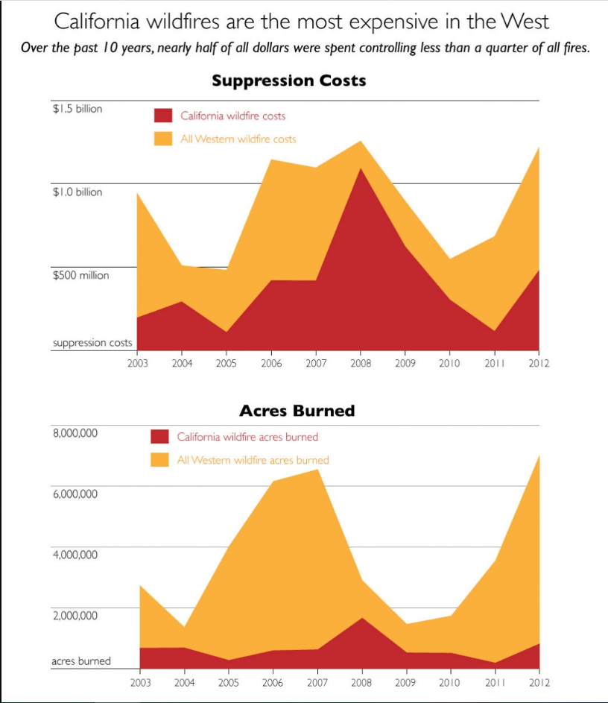
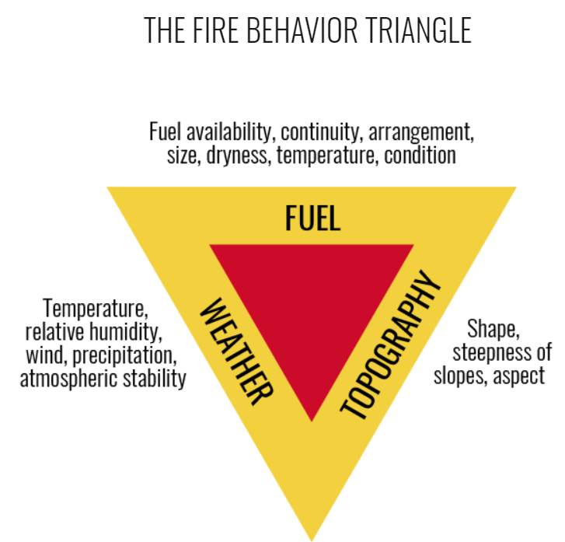
FINDINGS - CALIFORNIA SPECIFIC IMPACT

Slide 7
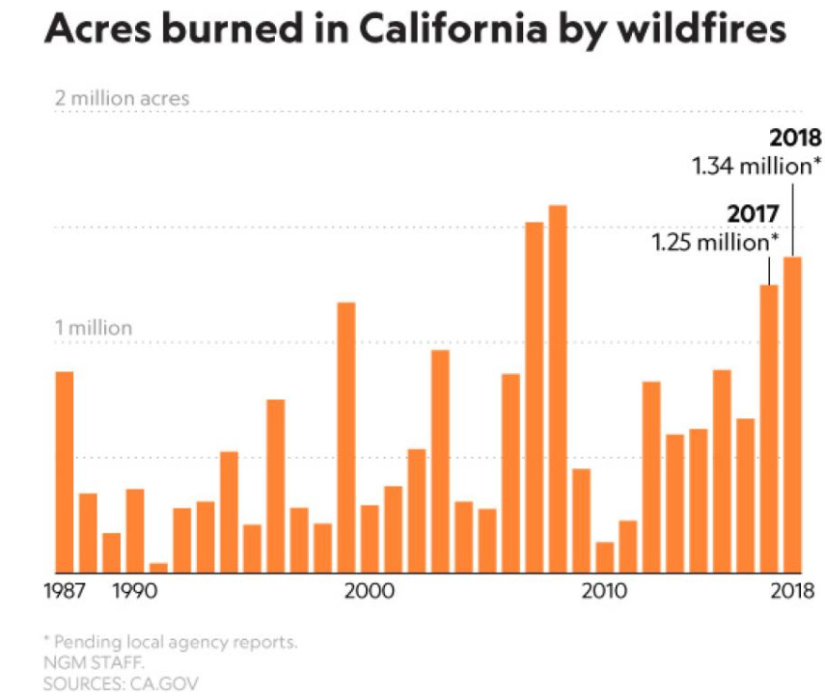
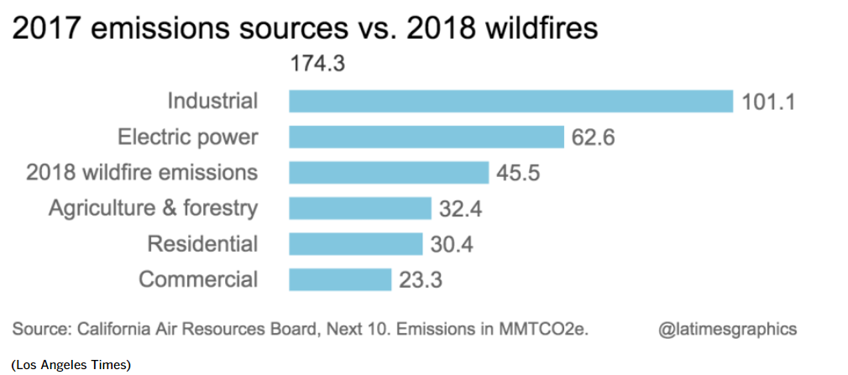
PREDICTION – WITHOUT PREVENTION CARBON EMMISIONS WILL LEAD TO MORE WILDFIRES FROM WILDFIRES!!

Slide 8
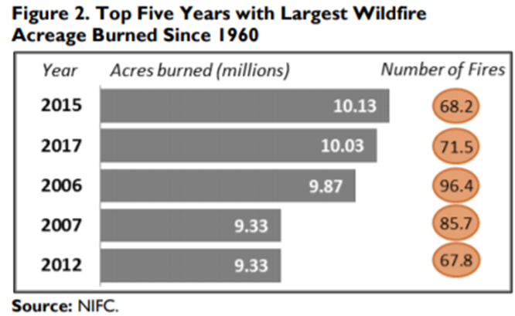
FINDINGS/INTERPRETATION OF DATA
Most wildfires are human-caused (88% on average from 2014 to 2018), although the wildfires caused by lightning tend to be slightly larger and burn more acreage (51% of the average acreage burned from 2014 to 2018 was ignited by lightning).
Although it is hard to predict future outcomes based on correlation of data purely based on scientific statistic data churns, it is possible to look at trends and draw a conclusion based on educated guess on past outcomes.
Most recent shocking trend

Slide 9
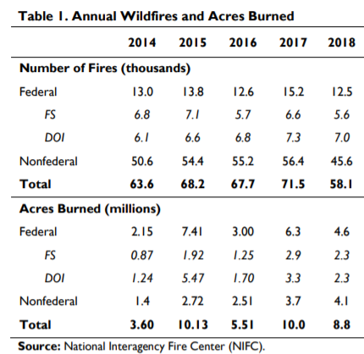
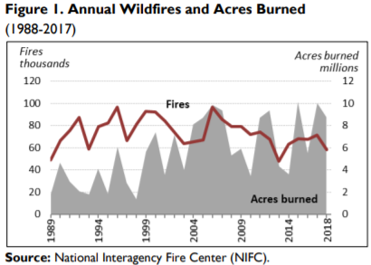
U.S. OVERALL IMPACT - WILDFIRES
In 2018, 53% of the nationwide acreage burned by wildfires was on federal lands (4.6 million acres; see Table 1). The other 47% of the acreage burned occurred on state, local, or privately owned lands but also accounted for 78% of the fires (45,559).
More wildfires occur in the East (including the central states), but the wildfires in the West are larger and burn more acreage (including Alaska, Arizona, California, Colorado, Idaho, Montana, New Mexico, Nevada, Oregon, Utah, Washington, and Wyoming)

Slide 10

CONCLUSION
Response to analysis question posed –
There is enough historical data to assert that :
Dry and/or excessive heat patterns with lack of moisture/rainfall contribute to the spread of wildfires and the inability to extinguish fires, causing greater than anticipated damage. In some cases, based on topography, windspeed may cause quicker spread of wildfire covering additional acres in a shorter period of time.
There is correlation between historical wildfires in California and the climate and weather patterns for California as it relates to trends in increased temperatures in decreased moisture leading up to longer duration of wildfires.

Slide 11
TECHNICAL REQUIREMENTS –CHALLENGES
Splinter to move through webpages by scraping data through loops
Used leaflet to geo map fire locations over past several years
Used plotly to visualize descriptive statistics
Used python, flask, PyMongo for data-serving backend
Mongodb used for storing data sources as collections without primary/foreign key relationships
JSON format for easy interpretation when working with Javascript during the front-end portions of project
JSON format to CSV to create data sets of weather data

Slide 12
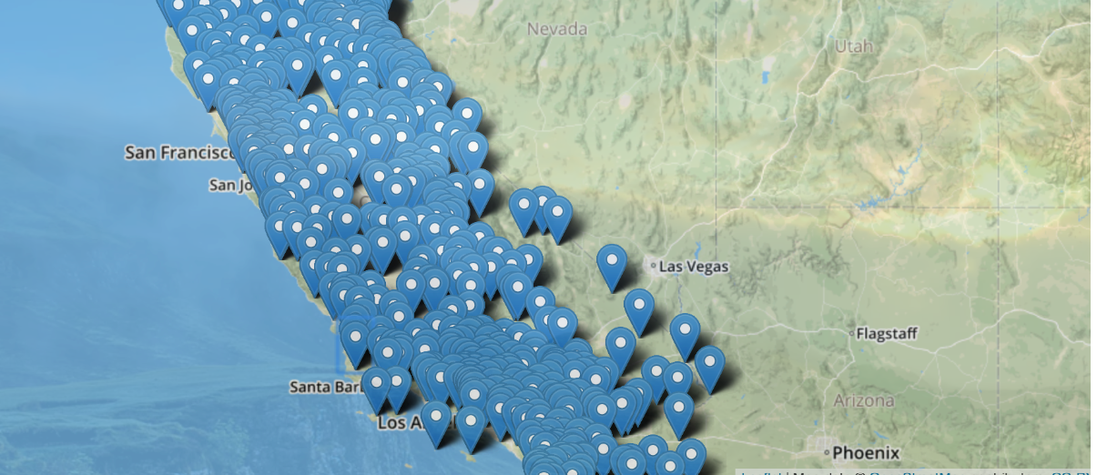
INITIAL OUTPUT OF WEATHER STATION MAP LEAFLET

Slide 13
CHALLENGES IN COLLECTING AND PRESENTING DATA
Limitations of number of weather stations that can be downloaded from the website - manually downloaded stations names and created API request for historical data for the weather stations.
Had to create subsets of data manually since State and County level data was not available or were incomplete to download directly
Web scrape tonnage of data would cause a crash and would need to re-run before data would complete

Slide 14
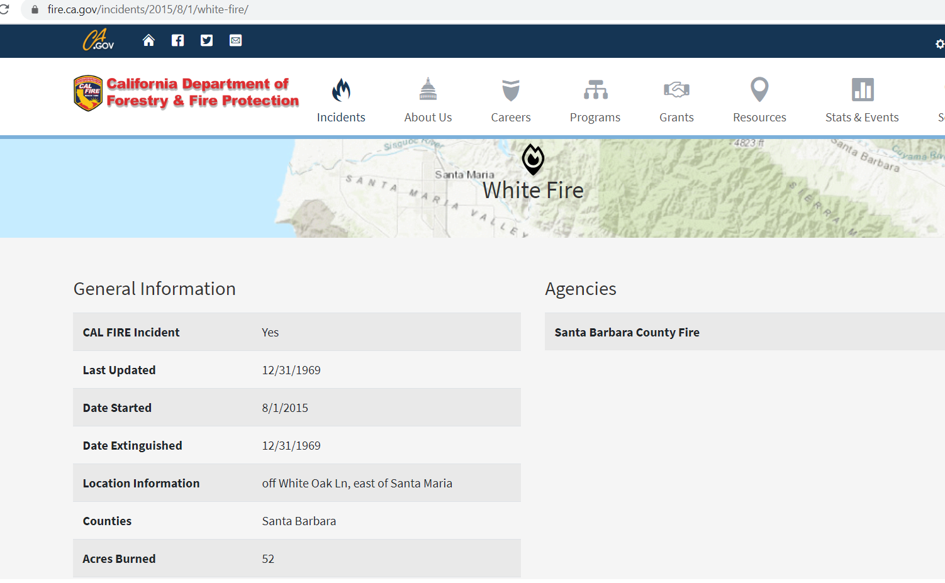
INNACURATE DATA FROM TRUSTED SOURCES ADDING TIME TO DATA CLEANUP
Scraping this government website that should have valid information proved to add additional manual labor to validate data with dates that were invalid in their system

Slide 15
SOURCES
The source of data used were the following websites:
https://www.fire.ca.gov/incidents/, https://www.ncdc.noaa.gov/cdo-web/search
PyMongo, CSV, BeautifulSoup, created lists, dictionaries, APIs
https://www.fire.ca.gov/incidents/
Web scraped data for 2019-2013 as historic_fire_data collection
Web scraped data for active as current_fire_data collection
https://www.ncdc.noaa.gov/cdo-web/search
historical weather data for all weather stations in California
https://visual-crossing-weather.p.rapidapi.com/forecast
Weather API for 5 day forecasts
https://www.kaggle.com/annieichen/top-20-largest-california-wildfires/data
Top 20 California Wildfires CSV
Research data sources
https://www2.calstate.edu/csu-system/news/Pages/understanding-fire.aspx
https://www.ncdc.noaa.gov/cag/national/time-series
https://crt-climate-explorer.nemac.org/
https://gacc.nifc.gov/oncc/
https://fas.org/sgp/crs/misc/IF10244.pdf
http://www.usa.com/rank/california-state--average-wind-speed--county-rank.htm?yr=9000&dis=&wist=&plow=&phigh=

